Slide 1
CSF 2113 Programming for Information Security
Penetration Testing (CLO 05)
Muhammad Humayoun, PhD
Assistant Professor
mhumayoun@hct.ac.ae
Abu Dhabi Men’s College

Slide 2
Introduction
Penetration Testing is used to find flaws in the system in order to take appropriate security measures to protect the data and maintain functionality.

Slide 3
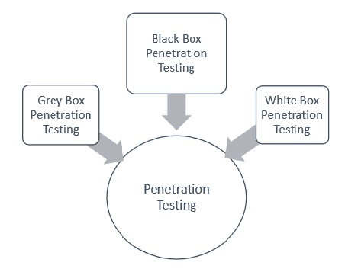
Types of Pen Testing
Black Box Penetration Testing
White Box Penetration Testing
Grey Box Penetration Testing

Slide 4
Black Box Penetration Testing
Tester has no idea about the systems that he is going to test.
In other words, the Penn tester is given “ZERO” information about the system inner workings
He is interested to gather information about the target network or system. For example,
in this testing, a tester only knows what should be the expected outcome and he does not know how the outcomes arrives
He does not examine any programming codes

Slide 5
Advantages of Black Box Penetration Testing
Tester need not necessarily be an expert, as it does not demand specific language knowledge
Tester verifies contradictions in the actual system and the specifications
Test is generally conducted with the perspective of a user, not the designer

Slide 6
Disadvantages of Black Box Penetration Testing
Particularly, these kinds of test cases are difficult to design.
Possibly, it is not worth, incase designer has already conducted a test case.
It does not conduct everything.

Slide 7
White Box Penetration Testing
This is a comprehensive testing, as tester has been provided with whole range of information about the systems and/or network such as Schema, Source code, OS details, IP address, etc.
White box penetration testing examines the code coverage and does data flow testing, path testing, loop testing, etc.

Slide 8
Advantages of White Box Penetration Testing
It ensures that all independent paths of a module have been exercised.
It ensures that all logical decisions have been verified along with their true and false value.
It discovers the logical errors
It finds the design errors that may have occurred because of the difference between logical flow of the program and the actual execution

Slide 9
Disadvantages of White Box Penetration Testing
A wide range of expertise is needed to perform such testing
As a consequence, it is expensive

Slide 10
Grey Box Penetration Testing
A tester usually provides partial or limited information about the internal details of the program of a system
Usually access of the source code is not provided to the tester
It can be considered as an attack by an external hacker who had gained illegitimate access to an organization's network infrastructure documents.

Slide 11
Advantages of Grey Box Penetration Testing
As there is clear difference between a developer and a tester, so there is least risk of personal conflict and bias
You don’t need to provide the internal information about the program functions and other operations

Slide 12
Areas of Penetration Testing
Network Penetration Testing
the physical structure of a system needs to be tested to identify the vulnerability and risk which ensures the security in a network.
Application Penetration Testing
the logical structure of the system needs to be tested.
The response or workflow of the system
test the ability of the respective organization to prevent unauthorized access to its information systems.
For instance, using social engineering that gathers information on human interaction

